Slide 1
University – Industry – Community Collaboration in STEM Education
Rohaya Husny Pahmy
Research Officer
Universiti Sains Malaysia
The 3rd Belt And Road Teenager Maker Camp & Teacher Workshop 2019

Slide 2
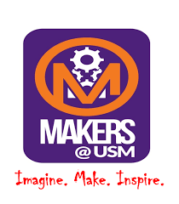
Collaboration Framework
Makers@USM
Program Funding
COMMUNITY
Students participation
INDUSTRY
Industry-driven projects
ASM Expertise (TRSM, ASM Fellow, YSN)
High schools students
USM Niche Area
USM Expertise
USM Lecturers, Staff & Students
Industry expertise
ASM & CREST
UNIVERSITY
GOVERNMENT

Slide 3
University- Industry - Community Collaboration in STEM Education Program
Cultivate students interest and drive passion towards STEM career path
USM EXPERTISE (ACADEMIA & STUDENTS)
PROGRAM
FUNDING
Seeding & Nurturing Sustainable Talent Pipeline in STEM
INDUSTRY LINKAGES
Develop Technical & Soft Skills During Hands On Activities
UNIVERSITY
GOVERNMENT
INDUSTRY PARTNERS
COMMUNITY
Enhancement of STEM teaching & learning by experiential learning approach
Develop The Global Human Capital As One Of The Talent R&D Pipeline In Engineering
Strengthening and expanding STEM knowledge towards R&D and innovation
Platform for creation of knowledge and innovation skills and to increase students enrolment in STEM education during IHLs.
Creation of Knowledge & Innovation Skills & Culture
Platform for students to come together and get industry exposure and career guidance from various industries
Softkills/Interpersonal skill Developments
HIGH SCHOOL STUDENTS PARTICIPANTS
INDUSTRY –DRIVEN PROJECTS
INDUSTRY EXPERTISE
Jabatan Pendidikan Negeri Perak

Slide 4
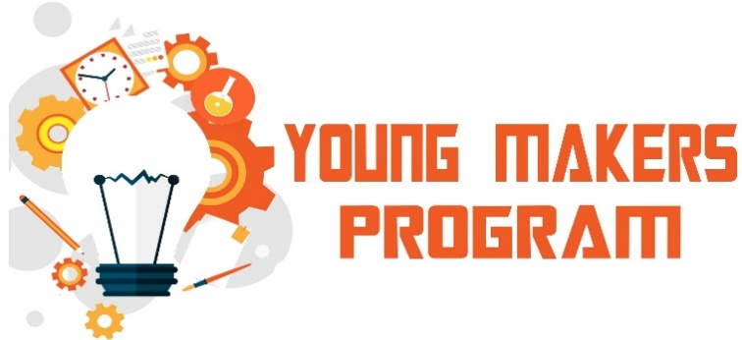
Universiti Sains Malaysia & Academy Of Sciences Malaysia
Collaboration Program
Concept
Participants
6 month outreach program for high schools students to gain industry exposure through interaction with industry representative & hands on activities with technology platforms.
High School (Secondary)
Form 1, Form 2 and Form 4 students
Program Structure
Company Visit/University Lab Visit
Engineering Challenge
Hands on Workshop
Industry Mentoring Session
Project Presentation

Slide 5
Program Objectives
Stimulate student interest and drive passion towards STEM by creation of innovators skill & culture
Stimulate innovators culture & skills and inspire Malaysian interest towards life-long learning of science, technology and innovation
Develop learning experiences that promote critical and process driven thinking skills
Develop sustainable talent pipeline in STEM by creating talent pool in STEM related studies to inspire the young generation to pursue careers in STEM
Develop technical skills & creative mindsets through hands-on activities and experiential learning approach

Slide 6
Program Background
The program is designed for the high school students to stimulate student interest and drive passion towards STEM by creation of innovators skill & cultures.
This program focused on developing the young generation with the 21st century skills which are learning and innovation skills, digital literacy skills and experiential STEM learning through project-based learning.
By participating in this program, the students will enhance their technical skills by exposure to hands-on activities to ideate and innovate through the application of knowledge of STEM using various engineering platform and tools.

Slide 7
Program Background
STEM LEARNING APPROACH THROUGH YOUNG MAKERS PROGRAM
TECHNICAL
SKILLS
SOFTSKILLS
LEARNING SKILLS
Critical Thinking & Problem Solving
Creative, innovative & resourceful
Ability to communicate proficiently
STEM Knowledge
(Engineering, Physic, Chemistry, Biology,Math, etc)
ICT literacy
(Programming/
Coding)
Analytical Skills
Teamwork
Initiative
Communication

Slide 8
Program Background
Promote STEM education through project-based learning.
Students will be exposed to build their own projects, and learn about programming, design thinking, and project prototyping.
Hands on Activity
Project Prototyping
Skills & Knowledge Development

Slide 9
Program Framework
BOOTCAMP
PROJECT DEVELOPMENT
MAKERS OPEN DAY
Makers Innovation Challenge
Project Showcase
Award Presentation
Project Briefing
Technical Training
Design Thinking
Makers/STEM Workshop
Project Ideation
Pitching Skills
Project Management
Prototyping
Mentoring Session

Slide 10
Program Outcomes
By participating in this program, students will experience the following advantages:
Seeding & Nurturing Sustainable Talent Pipeline in STEM
Enhancement of STEM teaching & learning by experiential learning approach
Creation of Knowledge & Innovation Skills
The students will be able to enhance & improve the technical knowledge in STEM through the hands-on learning towards research and innovation
The students will have better insight on the STEM field of study.
Ability to engage and apply the STEM knowledge to conduct STEM research
Soft skills/Interpersonal skill Developments
The students will be able to develop their interpersonal skills in term of communication skills, working collaboratively in teams as well as building the self-confidence.

Slide 11
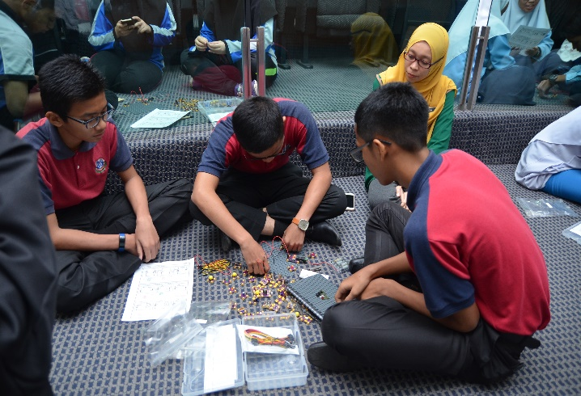
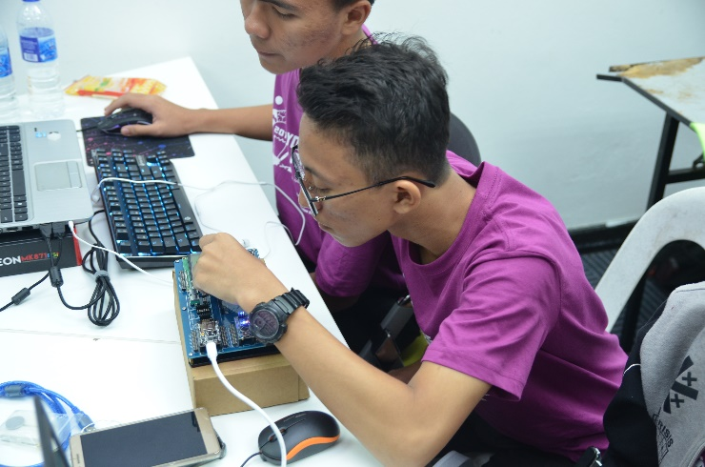
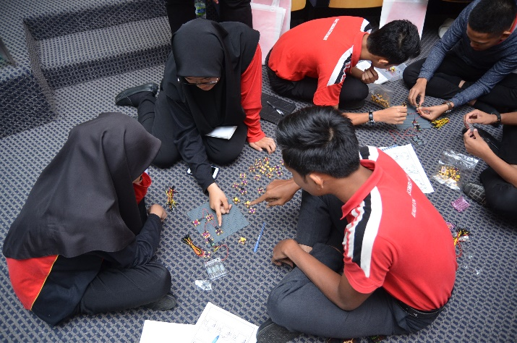
ARDUINO WORKSHOP
STEM ELECTRONIC WORKSHOP

Slide 12
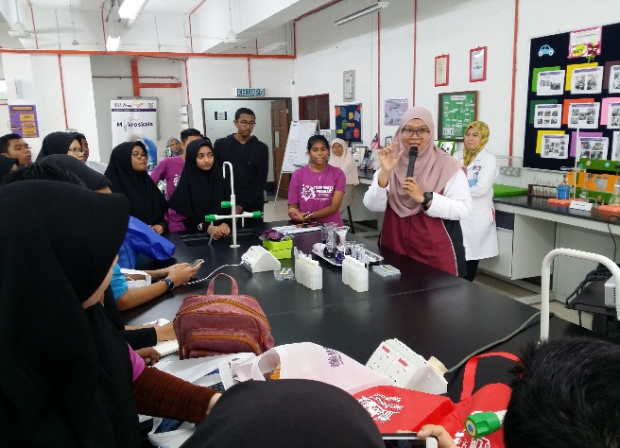
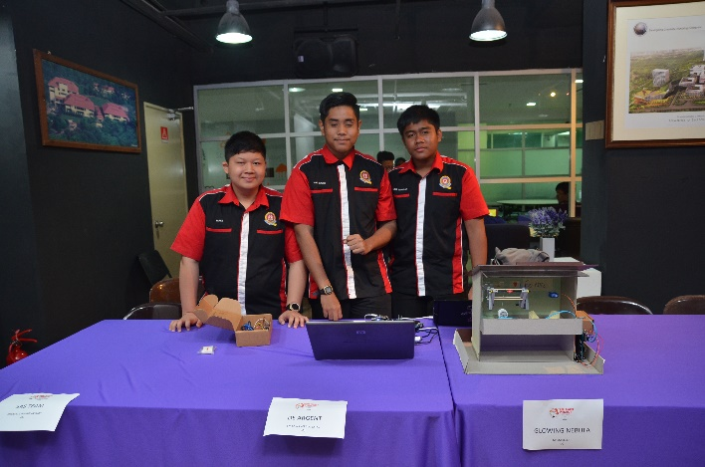
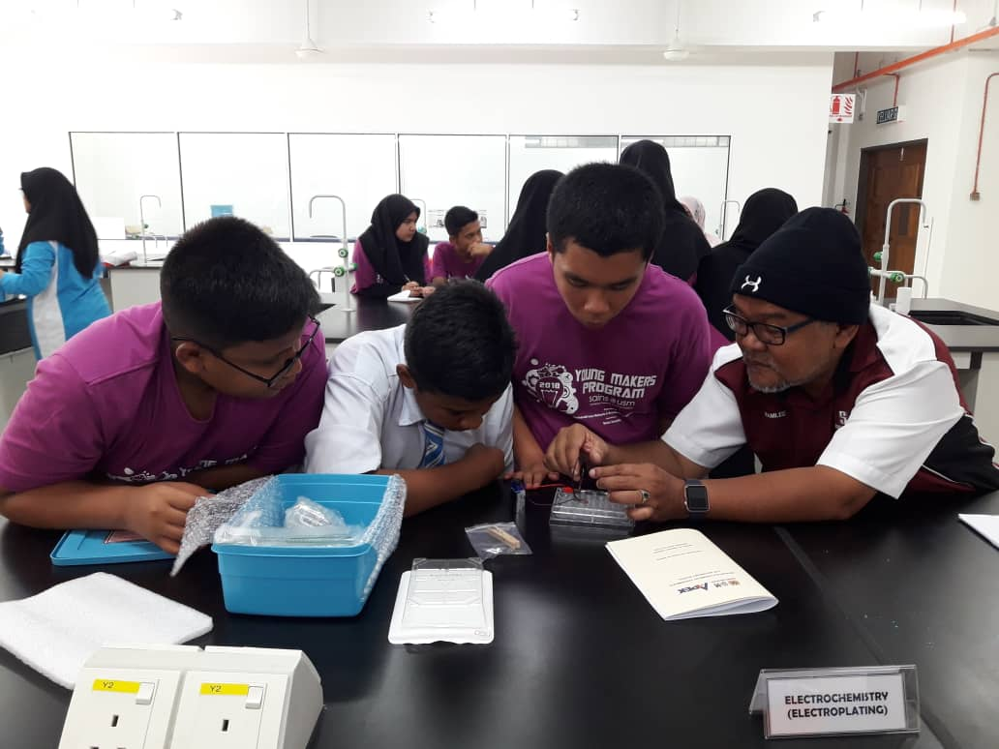
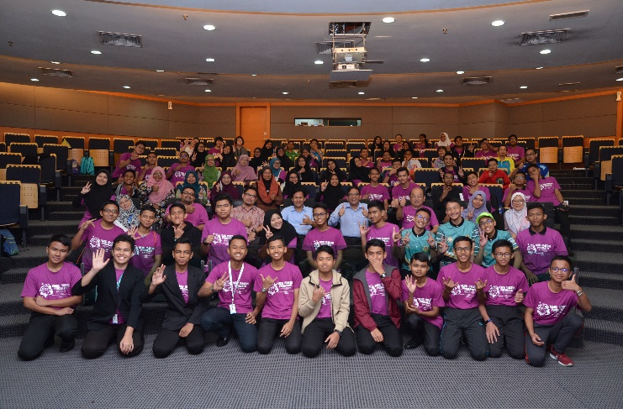
MICROSCALE CHEMISTRY WORKSHOP
MAKERS INNOVATION CHALLENGE FINAL PRESENTATION

Slide 13
Thank You

